Slide 1
SELF CAR PARKING SYSTEM USING AI
Presented by:
V.Sri Kari(192211509)
G.Tejaswi(192211748)

Slide 2
INTRODUCTION
Overview of the Self-Parking Car System:
Autonomously parks a vehicle using sensors, AI algorithms, and control systems.
Detects parking spaces, plans paths, and maneuvers the car
Importance of AI in Modern Automotive Technology:
Enhances safety by reducing accidents and assisting in complex scenarios.
Improves convenience with autonomous features and efficient parking.
Drives innovation and meets growing consumer demand.
Enables future integration with other systems and smart city infrastructure.

Slide 3
KEY COMPONENTS
Sensors and Cameras:
Ultrasonic Sensors: Measure the distance to nearby objects for precise parking.
Radar: Detects obstacles and their movement around the vehicle.
Lidar: Creates detailed 3D maps of the environment for accurate positioning.
Cameras: Provide visual input for detecting lanes, parking lines, and obstacles.
Machine Learning Algorithms:
Object Detection: Identifies obstacles, parking lines, and free spaces using computer vision techniques.
Path Planning: Calculates the optimal path to maneuver the vehicle into the parking space.
Control Algorithms: Adjust steering, acceleration, and braking to follow the planned path.
Control Systems:
Steering Control: Adjusts the steering angle based on the planned path.
Speed Control: Manages acceleration and braking to control the vehicle's speed.
Integration: Coordinates between sensors, algorithms, and actuators to execute parking maneuvers.

Slide 4
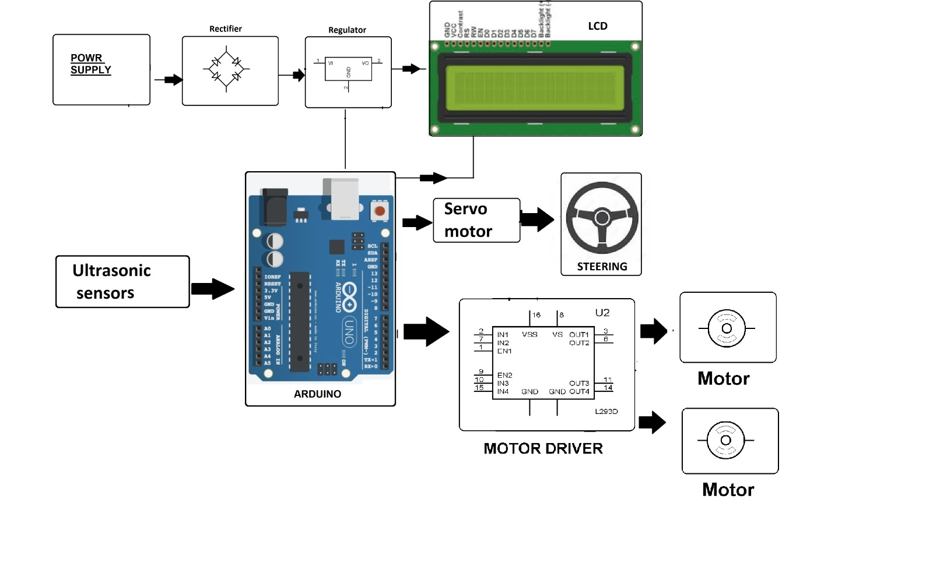
SYSTEM ARCHITECTURE

Slide 5
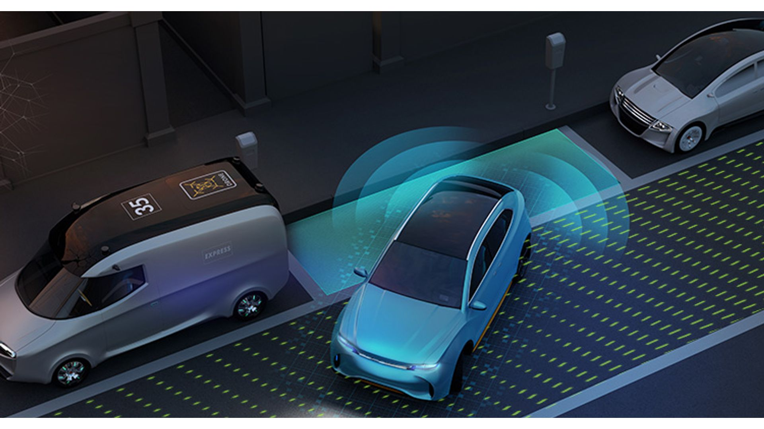
SENSORS AND CAMERAS
Ultrasonic Sensors:Measure the distance to nearby objects for precise parking.
Radar:Detects obstacles and their movement around the vehicle.
Lidar:Creates detailed 3D maps of the environment for accurate positioning.
Cameras:Provide visual input for detecting lanes, parking lines, and obstacles.

Slide 6
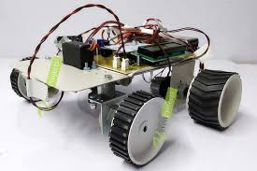
MACHINE LEARNING ALGORITHMS
Object Detection:Identifies obstacles, parking lines, and free spaces using computer vision techniques.
Path Planning:Calculates the optimal path to maneuver the vehicle into the parking space.
Control Algorithms:Adjust steering, acceleration, and braking to follow the planned path.

Slide 7
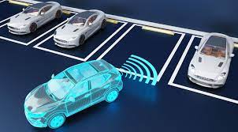
DATA COLLECTION
Gathering Data:Collect data from sensors and cameras in various parking scenarios.
Annotating Data:Label the collected data to identify parking lines, obstacles, and free spaces.

Slide 8
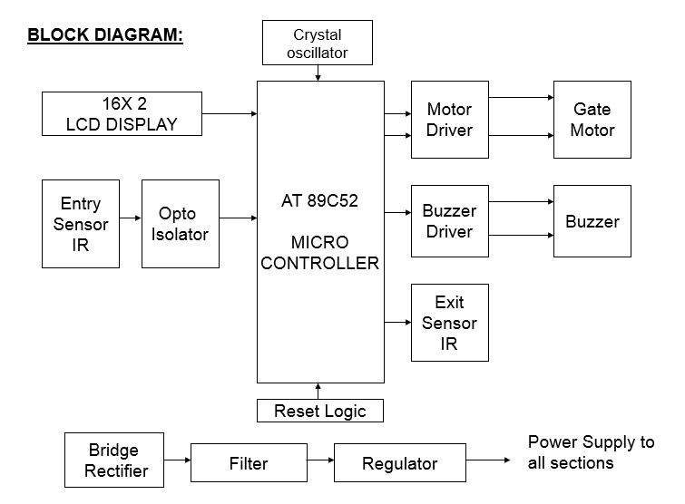

Slide 9
ALGORITHM DEVELOPMENT
Object Detection (CNN):Train a Convolutional Neural Network (CNN) to detect parking lines, obstacles, and free spaces.
Path Planning (RRT, A):Use algorithms like Rapidly-exploring Random Trees (RRT) or A* to plan a collision-free path to the parking spot.
Control Algorithms (PID, MPC):Implement Proportional-Integral-Derivative (PID) controllers or Model Predictive Control (MPC) to execute the planned path.

Slide 10
SIMULATION
Importance of Simulation:
Allows testing and refinement of algorithms in a controlled environment before real-world deployment.
Helps identify and fix potential issues without risking vehicle damage or safety.
Tools for Simulation:
CARLA: Open-source simulator for autonomous driving research with realistic urban environments.
Gazebo: Robot simulation tool providing accurate physics and sensor modeling for various autonomous systems.

Slide 11
INTEGRATION
Integrating Components:Combine sensors, cameras, machine learning algorithms, and control systems into the vehicle's architecture.
Ensure seamless communication and coordination between all components for effective operation.
Ensuring Real-time Processing:Implement systems capable of processing sensor data and executing control commands in real-time.
Optimize algorithms and hardware to handle dynamic environments and rapid decision-making.

Slide 12
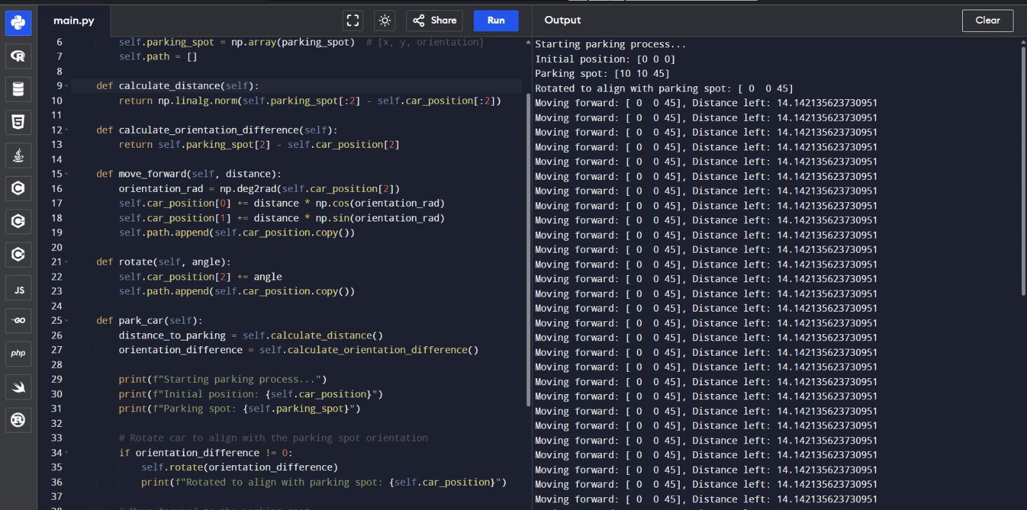
OUTPUT

Slide 13
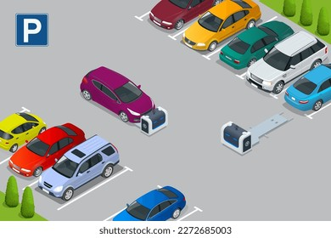
CHALLENGES AND CONSIDERATIONS
Safety:
Ensure the system can reliably detect and respond to unexpected obstacles and avoid collisions.
Accuracy:
Achieve high precision in object detection, path planning, and control to ensure successful parking and avoid errors.
Real-time Processing:
Implement systems capable of processing data and making decisions quickly to handle dynamic and fast-changing environments.
Robustness:
Design the system to perform consistently in various weather conditions, lighting situations, and diverse parking environments.

Slide 14
CONCLUSION
Summary of the Self-Parking Car System:
Recap the main components and functionality of the self-parking system, including sensors, algorithms, and control mechanisms.
Future Prospects:
Discuss potential advancements, such as integration with other autonomous driving features, smart city infrastructure, and improvements in AI and sensor technology.

